Slide 1

Shell Programming Lecture # 4
Dr. Muhammad Bilal Qureshi
m.qureshi@centralasian.uz
Central Asian University, Tashkent, Uzbekistan

Slide 2
Shell as Programming Language
$ for file in *
>do
>if grep -l POSIX $file
>then
>more $file
>fi
>done
posix This is a file with POSIX in it - treat it well
$
Note how the normal $ shell prompt changes to a > when you type shell commands. You can type away, letting the shell decide when you’re finished, and the script will execute immediately. In this example, the grep command prints the files it finds containing POSIX and then more prints the contents of the file to the screen. Finally, the shell prompt returns.

Slide 3
What will be the output of below Interactive Script?
$for file in *
>do
>echo "Processing $file"
>done

Slide 4
The Shell as Programming Language
You are almost certainly aware of the use of * as a wildcard to match a string of characters. What you may not know is that you can request single-character wildcards using ?
$ls file?
while [set] allows any number of single characters to be checked.
$ls file[abc]
[^set] negates the set— that is, it includes anything but the set you’ve specified.
$ls file[^abc]
Brace expansion using {} (available on some shells, including bash) allows you to group arbitrary strings together in a set that the shell will expand.
$ ls my_{finger,toe}s
Notes:
Ls file?
Will list file1 file 2 but not file12
Ls file[abc]
Will list filea fileb filec not filex
For file in *.txt matches any of the character
for file in *.txt
do
echo "Processing $file“
done

Slide 5
The Shell as Programming Language
Experienced UNIX users would probably perform this simple operation in a much more efficient way, perhaps with a command such as:
$ more `grep -l POSIX *`
or the synonymous construction
$ more $(grep -l POSIX *)
Notes:
$ grep -l POSIX * | more
Only output file name

Slide 6
The Shell as Programming Language
Going through this long rigmarole every time we want to execute a sequence of commands is a bore. We need to store the commands in a file, conventionally referred to as a shell script, so we can execute them whenever we like.
First, using any text editor you need to create a file containing the commands, create a file called first.
#!/bin/sh, is a special form of comment; the #! characters tell the system that the argument that follows on the line is the program to be used to execute this file. In this case, /bin/sh is the default shell program.
Notes:
-q: This option tells grep to operate quietly, meaning it will not output any matching lines. It simply sets the exit status based on whether a match is found.Exit status 0 if a match is found.
Exit status 1 if no match is found.
Absolute path … starting from the root should be less than 32 characters
In older systems (backward compatibility)
Since script is essentially treated as standard input to the shell it can contain any Linux Commands referenced by your path environment variable

Slide 7
The First Shell Script
#!/bin/sh
# first
# Thie file looks through all the files in the current directory
# for the string POSIX, and then prints the names of
# those files to the standard output.
for file in *
do
if grep –q POSIX $file
then
echo $file
fi
done
exit 0

Slide 8
The Shell as Programming Language
Note the absolute path specified in the comment. It may be wise to keep this shorter than 32 characters, for backwards compatibility, because some older UNIX versions can only use this limited number of characters when using #!, although Linux generally does not have this limitation.
Since the script is essentially treated as standard input to the shell it can contain any Linux commands.
The exit command ensures that the script returns a sensible exit code. A zero denotes success in shell programming.

Slide 9
The Shell as Programming Language
Notice that we have not used any filename extension, or suffix, on this example; Linux, and UNIX in general, rarely makes use of the filename extension to determine the type of a file.
We could have used .sh or added a different extension if we wished, but the shell doesn’t care.
Most preinstalled scripts will not have any filename extension, and the best way to check if they are scripts or not is to use the file command, for example,
file first
file /bin/bash
Notes:
First script
/bin/bash executable

Slide 10
Making the Script Executable
Now that we have our script file, we can run it in two ways. The simpler way is to invoke the shell with the name of the script file as a parameter, thus
$ /bin/sh first
This should work, but it would be much better if we could simply invoke the script by typing its name. We do this by changing the file mode to make the file executable for all users using the chmod command:
$ chmod +x first
We can then execute it using the command:
$ first or $./first

Slide 11
For conveniently Running the Script
export PATH=$PATH:$(pwd)
Above commands add current working directory to PATH variable so that script can directly run without ./, just like ls and other commands.
Alternative to add script to /usr/local/bin/ which is already added to PATH to directly run without ./
mv script.sh /usr/local/bin/
chmod +x /usr/local/bin/script.sh

Slide 12
Making a Script Executable
If you don’t have root permissions on your system, you could ask the system administrator to copy your file for you
The sequence of commands for the administrator to set ownership and permissions would be link:
# cp first /usr/local/bin
# chown root /usr/local/bin/first
# chgrp root /usr/local/bin/first
# chmod 755 /usr/local/bin/first
# chmod u=rwx,go=rx /usr/local/bin/firsts (same as above more obvious)
Notes:
Sudo (superuser do)
Root group members

Slide 13
Shell Syntax
So far, we have seen examples of simple shell programs, Time to look in greater depth the power of shell. Test small fragments interactively before combining them into bigger scripts, you can use bash shell to write large structured programs. We’ll cover :
Variables: strings, numbers, environments and parameters
Conditions: shell Booleans
Program Control: if, elif, for, while, until case
Lists
Functions
Commands built into the shell
Getting the results of command

Slide 14
Variables
No declaration required create when we use them. By default, stored as strings. Shell and some utilities to convert to numeric values.
Linux case sensitive so shell consider difference between foo and FOO.
To access the contents of variable or to use it in command put $ at the preceding. While when giving value just name is enough and its created dynamically.
Easy way to check the contents of variable is to echo it to the terminal preceding its name with $. E.g.
$ salutation=Hello
$ echo $salutation
Hello
$ salutation=”Yes Dear”
$ echo $salutation
Yes Dear
$ salutation=7+5
$ echo $salutation
7+5
Notes:
num=$(expr 5 + 10)
echo $num
# Output: 15
let num=10
let num=num+5
echo $num
# Output: 15
num=5
((num=num+10))
echo $num
# Output: 15

Slide 15
Variables (Cont..)
Note how a string must be delimited by quote marks if it contains spaces. Also note that there must be no spaces on either side of the equal sign.
We can assign user input to a variable by using the read command. This takes one parameter, the name of the variable to be read into, and then waits for the user to enter some text. The read normally completes when the user presses Enter. When reading a variable from the terminal, we don’t usually need the quote marks:
$ read salutation
Wie geht’s?
$ echo $salutation
Wie geht’s?

Slide 16
Use of Quotations in Shell Scripting
Normally, parameters in scripts are separated by whitespace characters (e.g., a space, a tab, or a newline character). If you want a parameter to contain one or more whitespace characters, you must quote the parameter.
The behavior of variables such as $foo inside quotes depends on the type of quotes you use. If you enclose a $ variable expression in double quotes, it’s replaced with its value when the line is executed. If you enclose it in single quotes, no substitution takes place. You can also remove the special meaning of the $ symbol by prefacing it with a \.

Slide 17
Examples
#!/bin/bash
echo "Enter two values:"
read a b
echo "a = $a"
echo "b = $b"
Input: 5 10
Output: a = 5
b = 10
#!/bin/bash
echo "Enter a single value (with spaces allowed):"
read a
echo "Value of a: $a“
Input:
"Hello World“
Output:
Value of a: Hello World
#!/bin/bash
echo "Enter two values:"
read a b
echo "a = $a"
echo "b = $b"
Input:
5
10 Output: a = 5
b = 10
#!/bin/bash
echo "Enter two values:"
read a b
echo "Value of a: $a"
echo "Value of b: $b“
Input:
Hello World
Output:
Value of a: Hello
Value of b: World

Slide 18
Show the Output
#!/bin/sh
myvar=”Hi there”
echo $myvar
echo “$myvar”
echo ‘$myvar’
echo \$myvar
echo Enter some text
read myvar
echo ‘$myvar’ now equals $myvar
exit 0
Notes:
Hi there
Hi there
$myvar
$myvar
Enter some text hello $myvar now equals hello

Slide 19
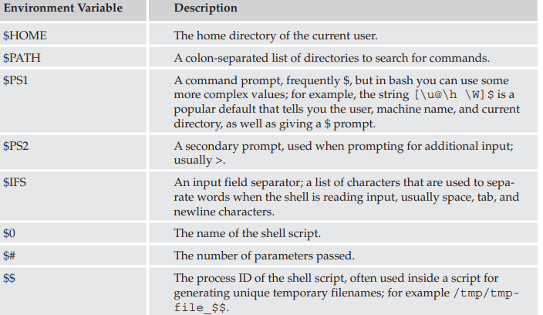
Environment Variables
When a shell script starts, some variables are initialized from values in the environment. These are normally capitalized to distinguish them from user-defined (shell) variables in scripts, which are conventionally lowercase.
Notes:
export PS1='[\u@\h \W]$ '
[john@server Documents]$

Slide 20
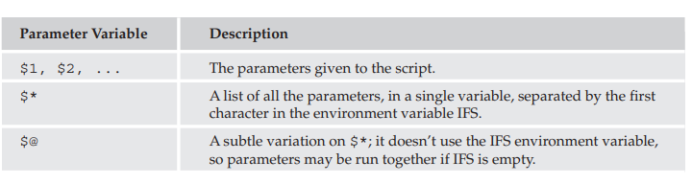
Positional Variables (Positional)
If your script is invoked with parameters, some additional variables are created. Even if no parameters are passed, the preceding environment variable $# still exists but has a value of 0. The parameter variables are listed in the following table.

Slide 21
Examples
echo \$PATH
$PATH
(no expansion)
echo ‘$PATH’
$PATH
(no expansion)
echo “$PATH”
/usr/local/bin:/usr/bin:/bin
(variable expansion)
#!/bin/bash
echo "First parameter: $1"
echo "Second parameter: $2"
./script.sh Hello World
First parameter: Hello
Second parameter: World
#!/bin/bash
echo "First parameter: $1"
echo "Second parameter: $2"
./script.sh “Hello World”
First parameter: Hello World
Second parameter:
Notes:
Printing special characters like $ in text.
Writing commands or scripts where $ needs to be treated literally.
Avoiding unintended variable expansion in strings.

Slide 22
Example running the Script with a b c arguments
#!/bin/bash
echo "Using \$@:"
for arg in $@; do
echo "[$arg]"
done
echo "Using \$*:"
for arg in $*; do
echo "[$arg]"
done
#!/bin/bash
echo "Using \"\$@\":"
for arg in "$@"; do
echo "[$arg]"
done
echo "Using \"\$*\":"
for arg in "$*"; do
echo "[$arg]"
done
Notes:
Both behave the same without quotes because IFS splits them into separate words.
a
b
c
a
b
c
a b c

Slide 23

Thank you
Notes:
Can do on personal systems so don’t have to type ./first to run the script can be done by just typing first
export PATH=$PATH:$(pwd)
mv script.sh /usr/local/bin/
chmod +x /usr/local/bin/script.sh

